Slide 1
U-Nets in a Self-Driving Segmentation Task
Deep Learning on Images and Signals
Nils Fahrni

Slide 2
How do segmentation models perform between scenes of city streets and non-city streets in the BDD100K dataset?
Research Question

Slide 3
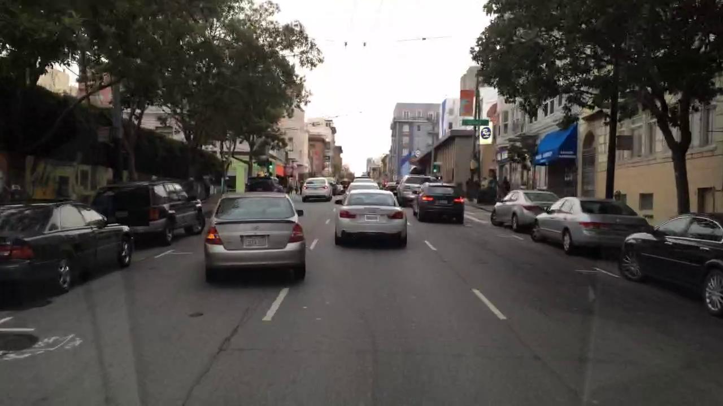
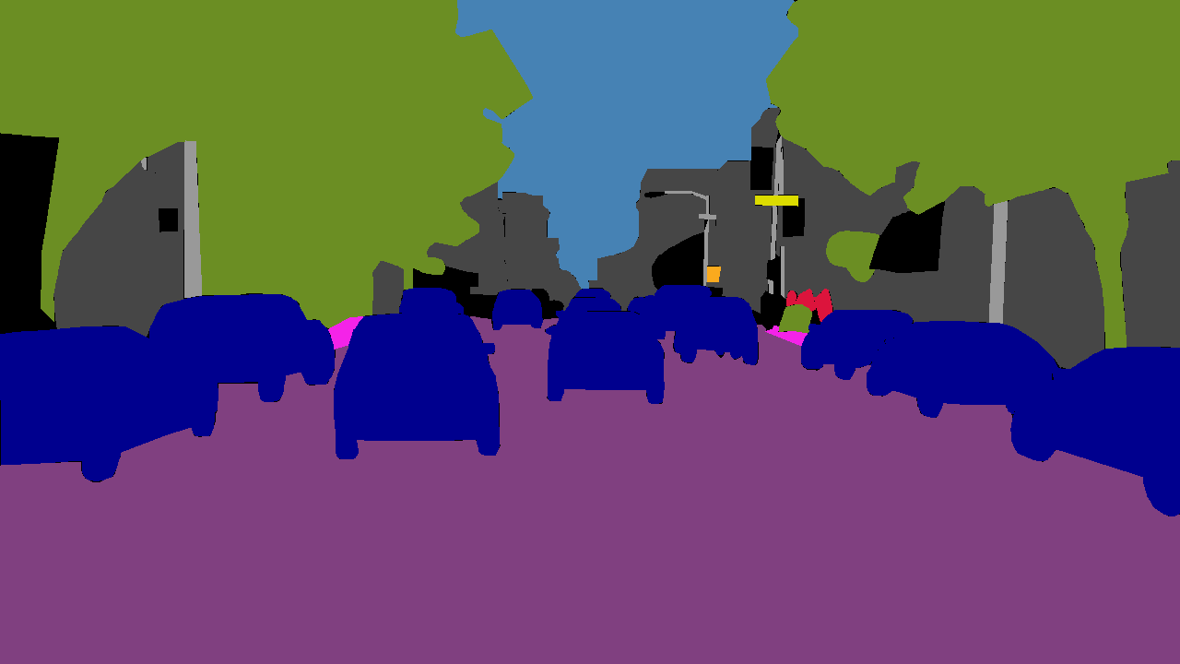
Dataset
BDD100k – Berkeley Deep Drive
Input Image
Ground Truth

Slide 4
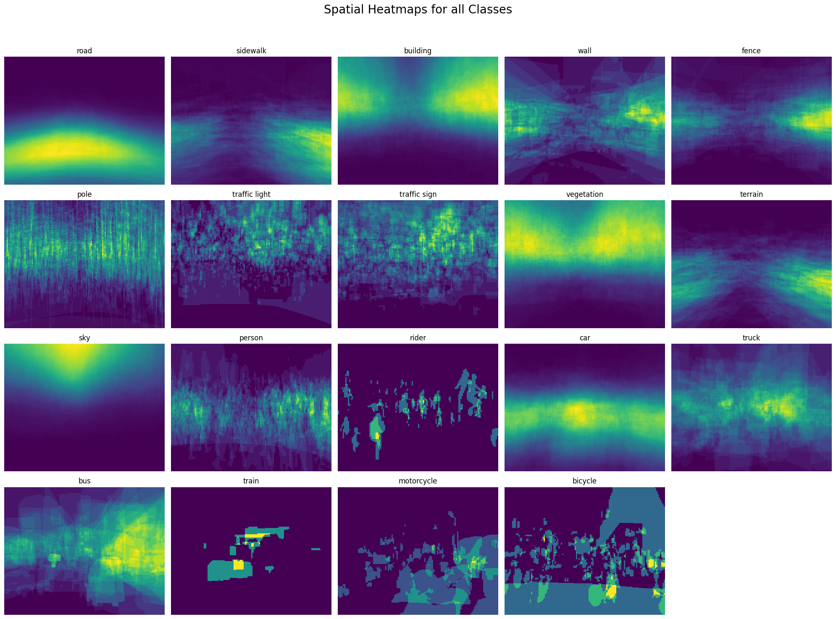
Dataset
19 Classes

Slide 5
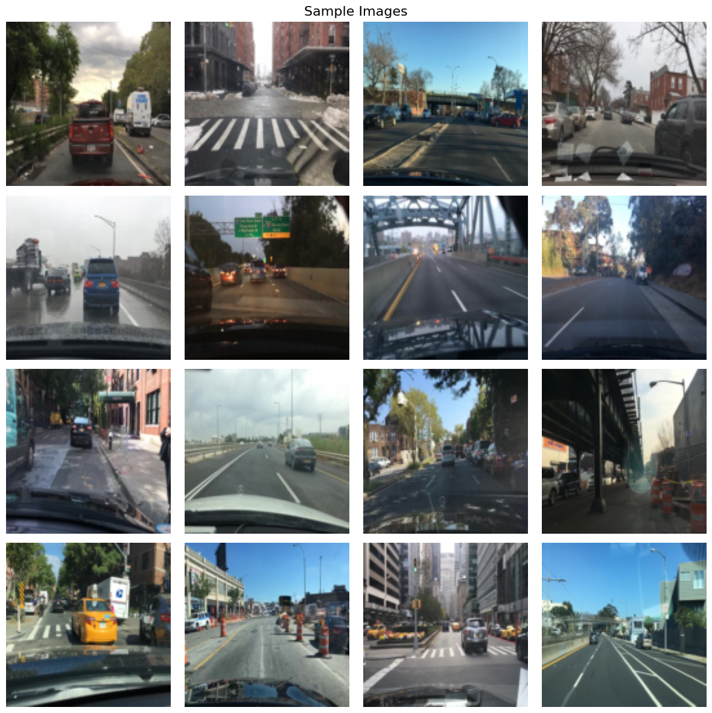
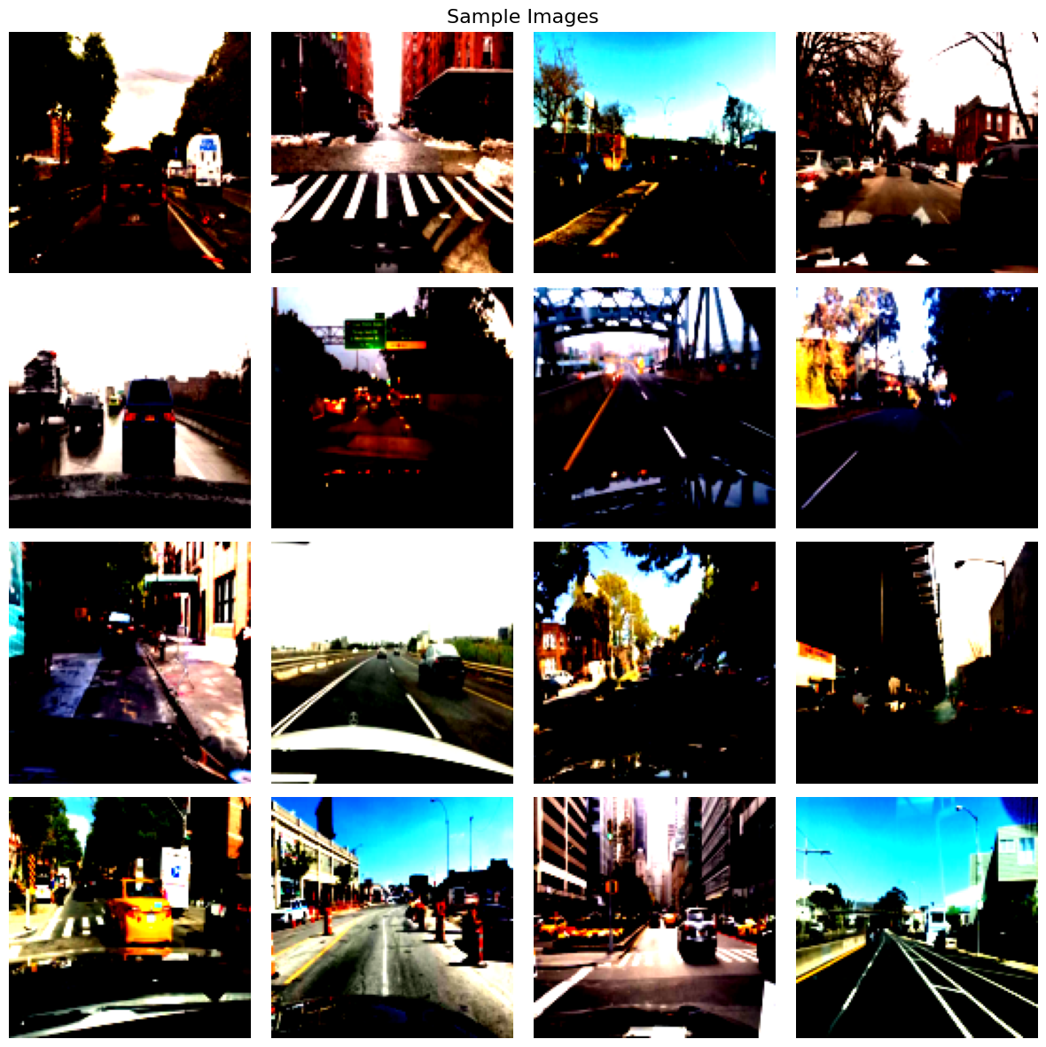
Preprocessing of Images
Step 1: Resize to 128 x 128 Pixels
Step 2: Normalize & Standardize

Slide 6
Model 1: Vanilla U-Net
Vanilla U-Net
Encoder Block
Decoder Block
Encoder 1
Encoder 1
Conv2d
ConvTranspose2d
…
BatchNorm2d
Conv2d
Encoder 4
ReLU
BatchNorm2d
Double Conv Block
Bottleneck
Conv2d
ReLU
Double Conv Block
BatchNorm2d
Decoder 1
Conv2d
Decoder 1
…
ReLU
BatchNorm2d
Decoder 4
ReLU
MaxPool2d

Slide 7
Model 2: Attention U-Net
Decoder Block
Attention U-Net
ConvTranspose2d
Encoder 1
…
Attention Block
Encoder 4
Conv2d
BatchNorm2d
Bottleneck
ReLU
Decoder 1
Double Conv Block
Decoder 1
Conv2d
…
BatchNorm2d
Decoder 4
ReLU

Slide 8





Training Environment
Slurm Environment
Scripts
Experiment Configs
Overfit
submit_job.sh
download.sh
upload.sh
Optimization
Trainer
Train
W&B
Runner
Validate
Overfit Experiment Run
Optimization Experiment Run
Models
…
Test

Slide 9
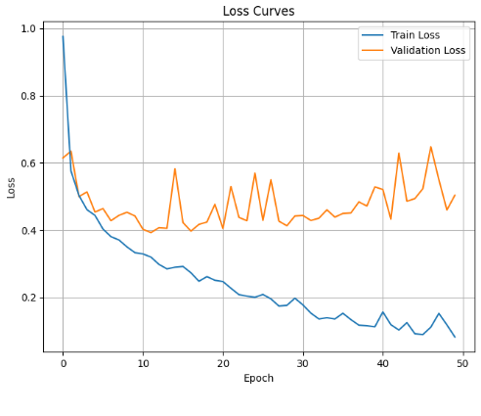
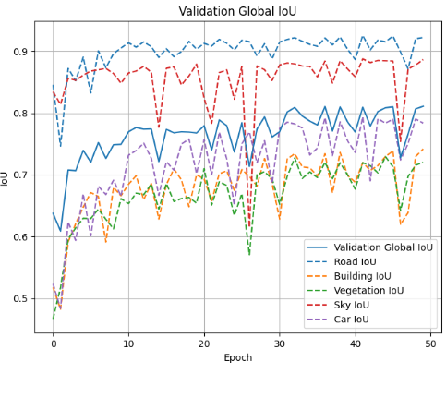
Results
Best performing Vanilla model: Vanilla U-Net with 128 base filters without regularization

Slide 10
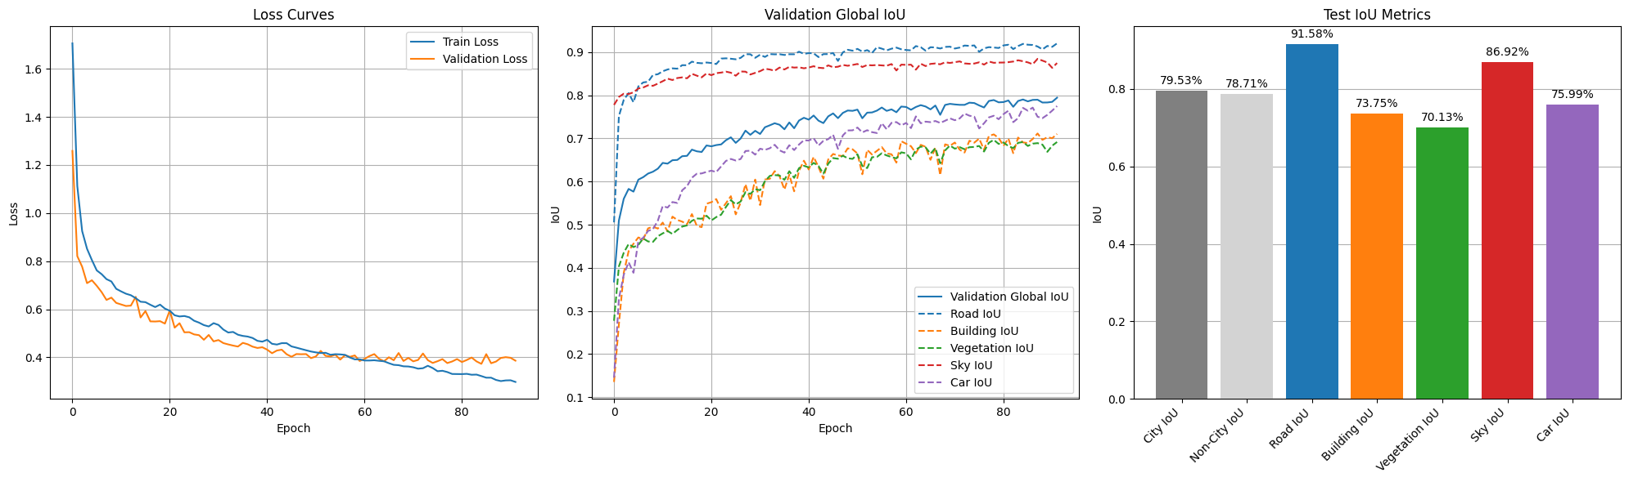
Results
Best performing Attention model: Attention U-Net with 64 base filters without dropout=0.2

Slide 11

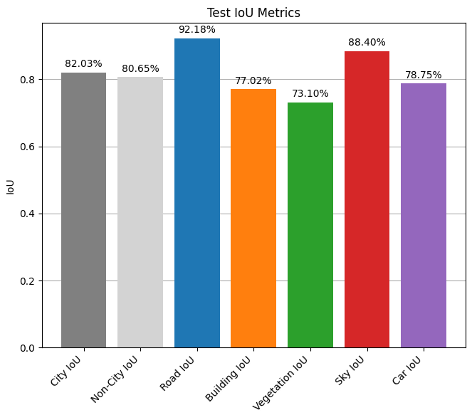
How do segmentation models perform between scenes of city streets and non-city streets in the BDD100K dataset?
Research Question
Vanilla U-Net
Attention U-Net

Slide 12
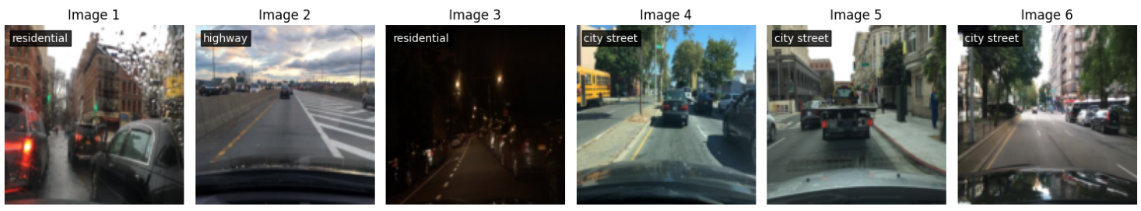
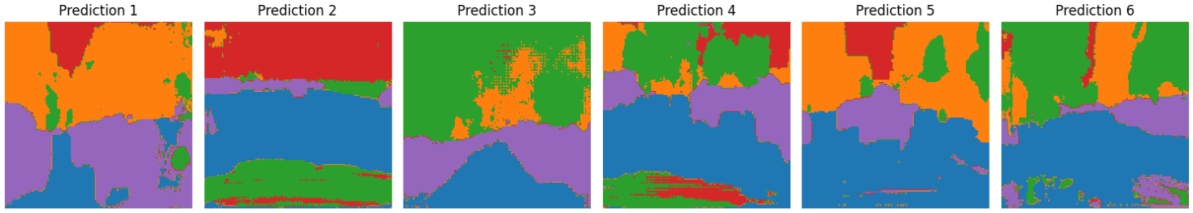
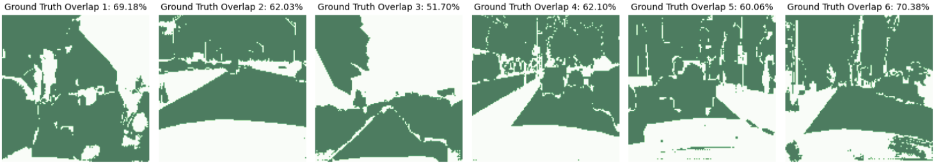

Slide 13
Q&A

